Slide 1
BIOE 498 / BIOE 599: Computational Systems Biology for Medical Applications CSE 599V: Advancing Biomedical Models Lecture 9: Estimating Confidence in Models and Parameters: I
Joseph L. Hellerstein*
Herbert Sauro**
*eScience Institute, Computer Science & Engineering
**BioEngineering

Slide 2
Agenda
Residual analysis
Parameter fitting and evaluation of a mathematical model using least squares regression
Hypothesis testing to evaluate models

Slide 3
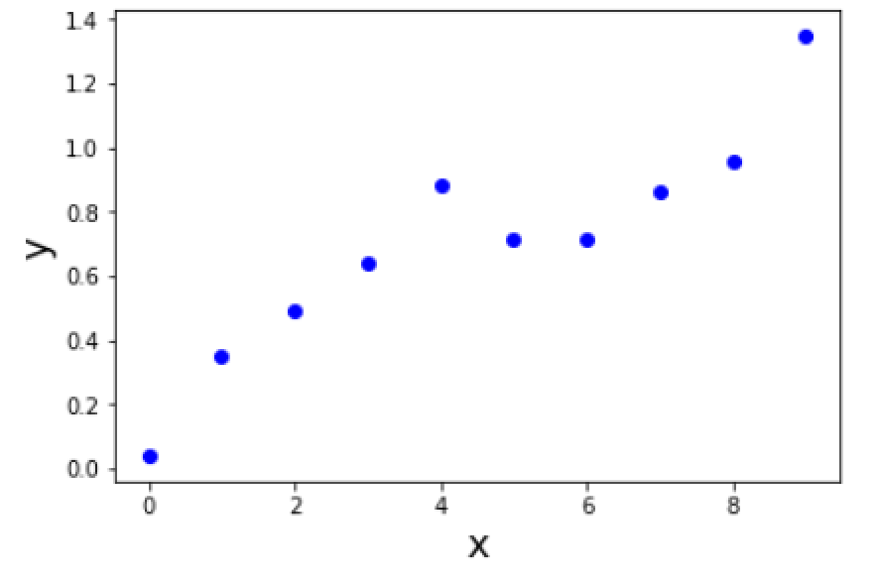
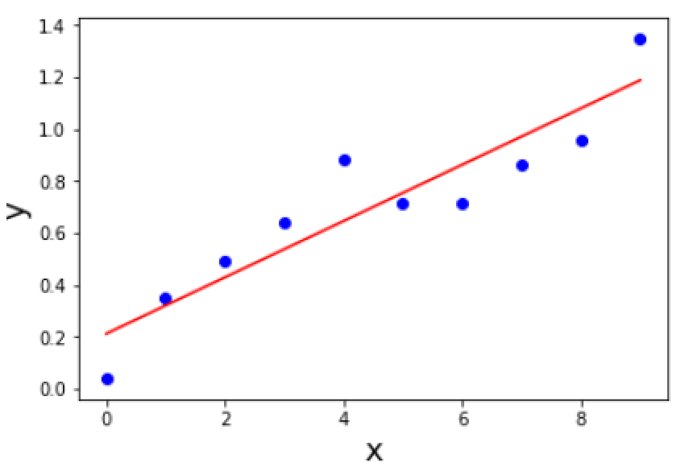
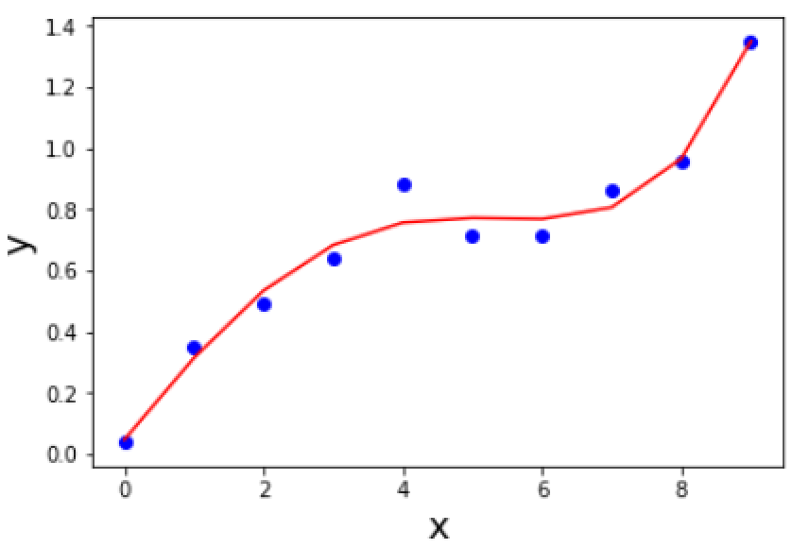


What is A Good Model?
Measured Data
$$y=ax+b$$
$$y=a_{1}x+a_{2}x^{2}+a_{3}x^{3}+a_{4}x^{4}+b$$

Slide 4
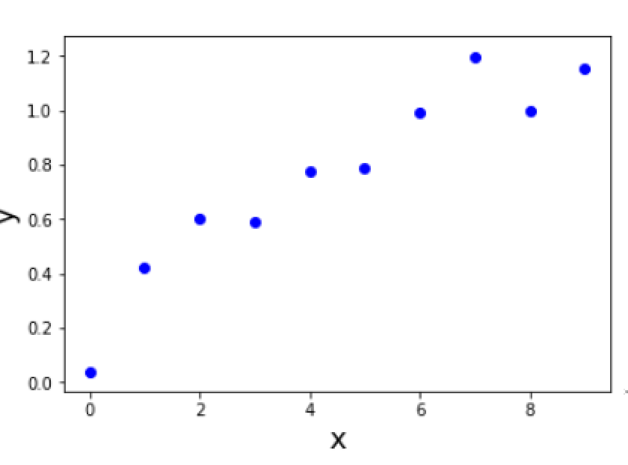
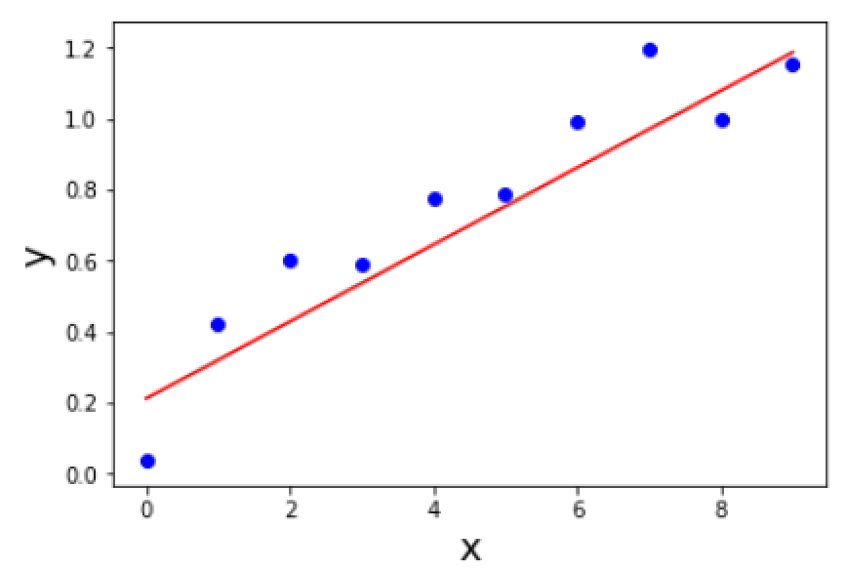
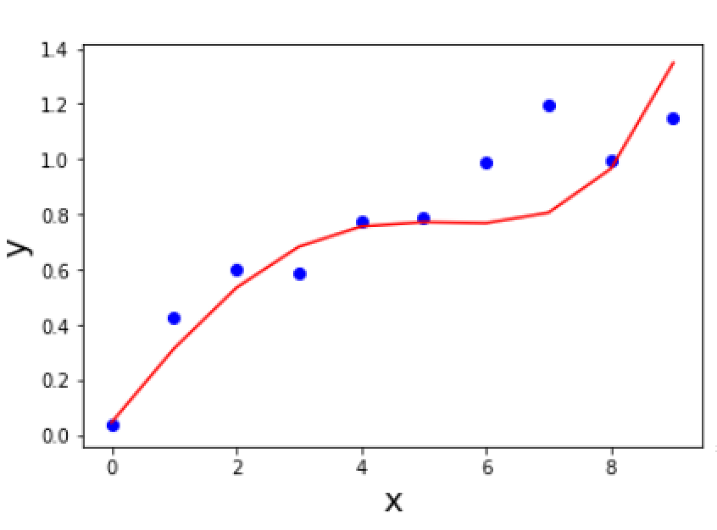
Generalizing Model to New Data
Data 2
Which is the better model now?

Slide 5


What is A Good Model?
Data 1
Data 2
$$y=ax+b$$
$$y=a_{1}x+a_{2}x^{2}+a_{3}x^{3}+a_{4}x^{4}+b$$
Fits measurement data
Simple (e.g., few parameters)
Generalizes to new measurement data

Slide 6
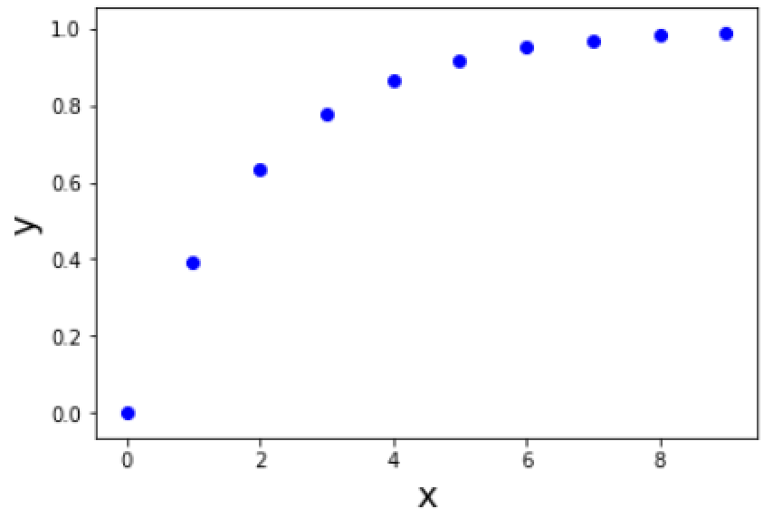
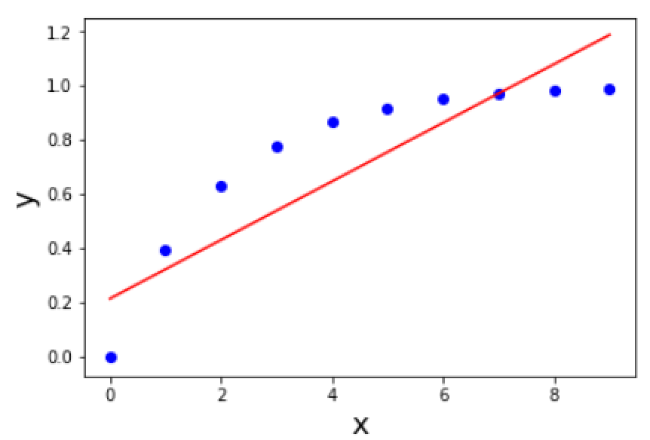
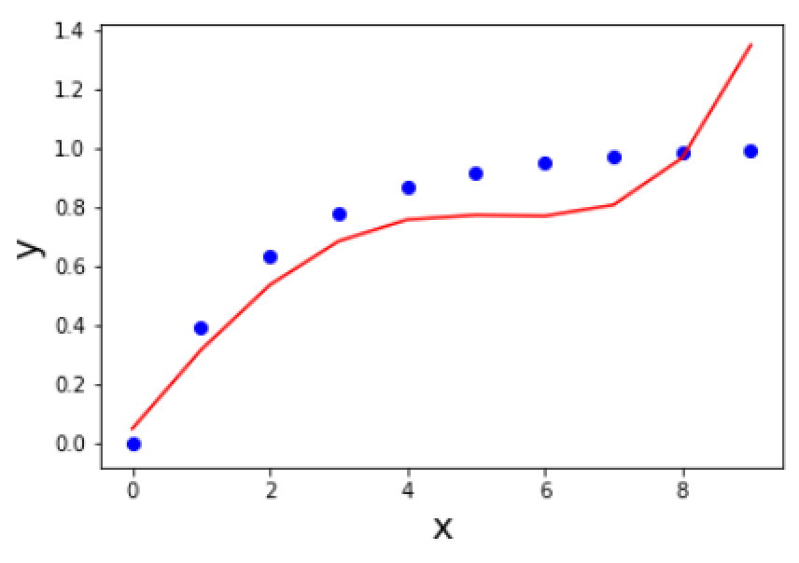
We Never Know if a Real World Model is Correct!
Data Without Measurement Errors

Slide 7
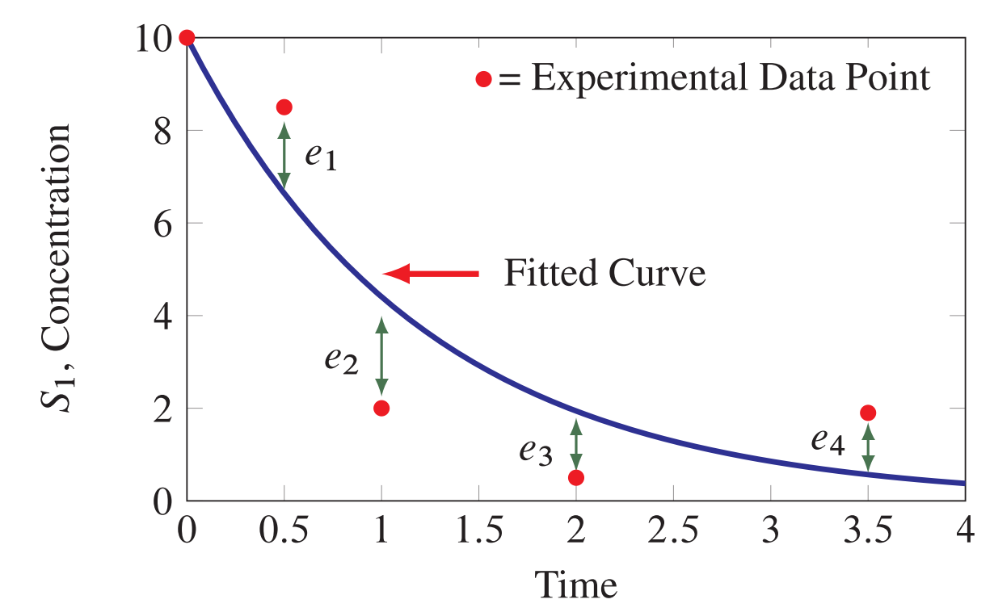
Residuals = Experimental - Fitted
Residual

Slide 8
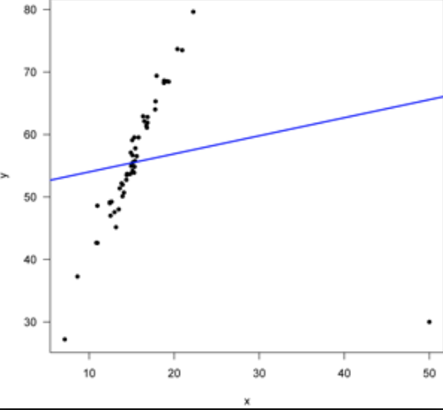
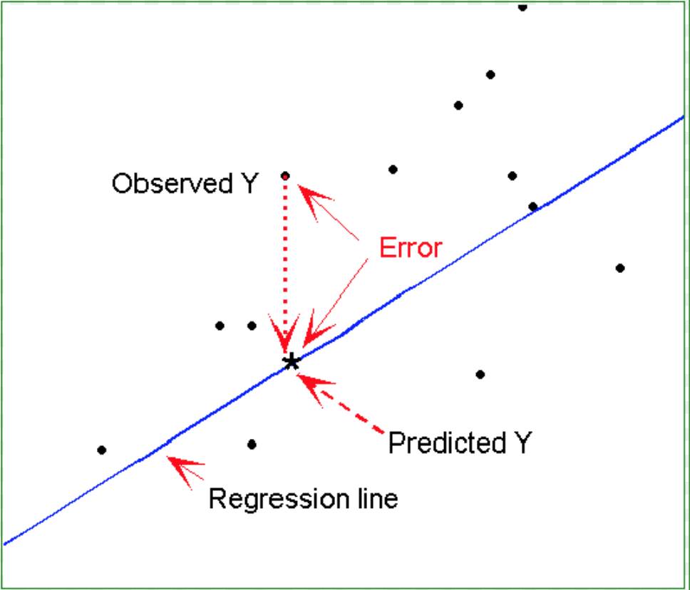
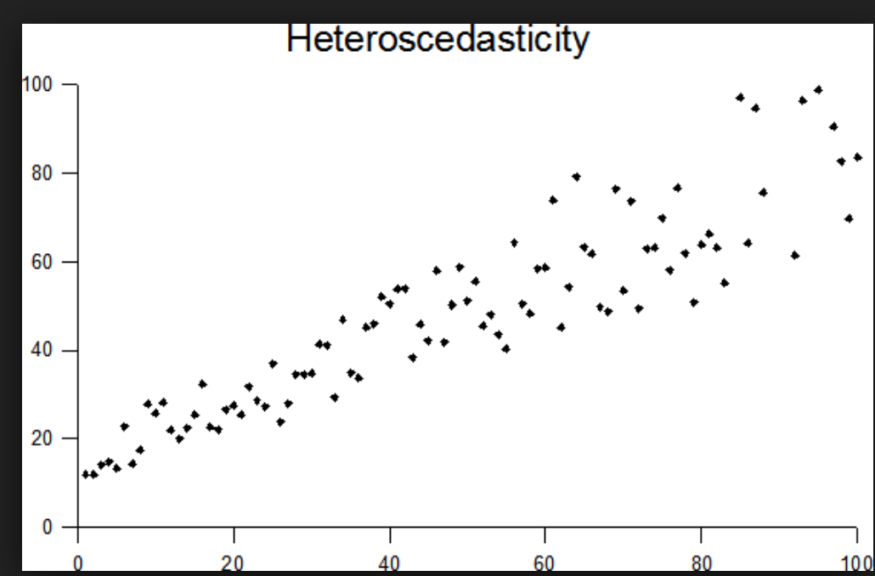
What Residuals Tell Us About Models
Likely Outlier
Functional Bias
Heteroschodasticity

Slide 9
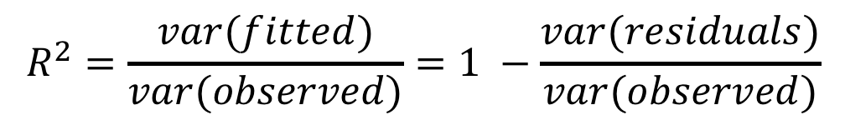



Quantifying Model Quality: $R^{2}$
$$R^{2}=\frac{var(fitted)}{var(observed)}=1 −\frac{var(residuals)}{var(observed)}$$
$$y=ax+b$$
$$y=a_{1}x+a_{2}x^{2}+a_{3}x^{3}+a_{4}x^{4}+b$$
0.85
0.97
Data 1
0.85
0.76
Data 2

Slide 10
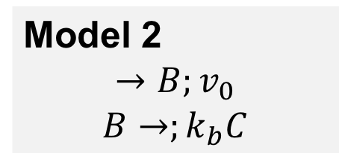
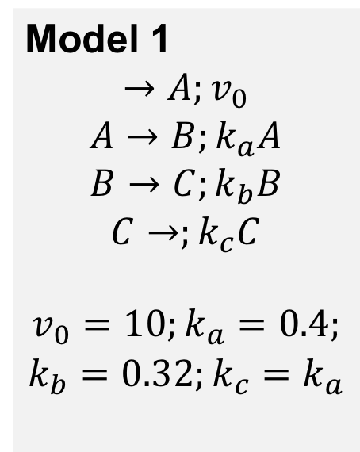
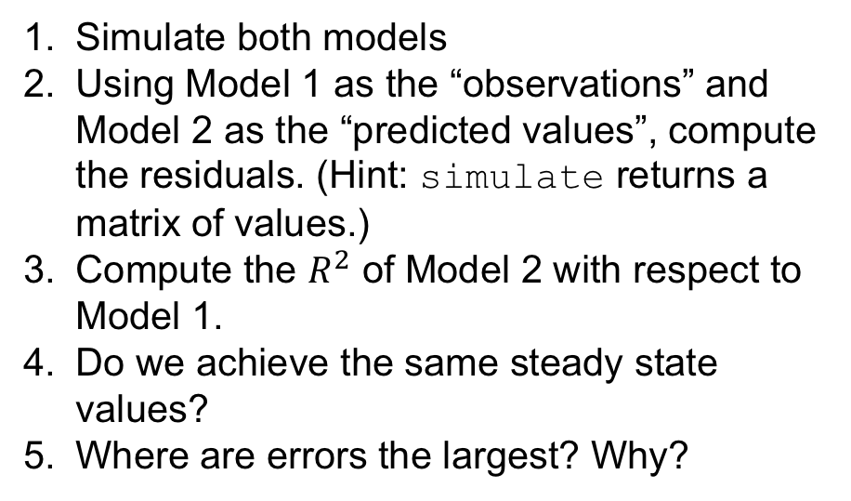
Exercise: Compare Models Using Residuals
Model 1
$$→A;v_{0}$$
$$A→B;k_{a}A$$
$$B→C;k_{b}B$$
$$C→;k_{c}C$$
$$v_{0}=10;k_{a}=0.4;$$
$$k_{b}=0.32;k_{c}=k_{a}$$
Model 2
$$→B;v_{0}$$
$$B→;k_{b}C$$
Simulate both models
Using Model 1 as the “observations” and Model 2 as the “predicted values”, compute the residuals. (Hint: simulate returns a matrix of values.)
Compute the $R^{2}$ of Model 2 with respect to Model 1.
Do we achieve the same steady state values?
Where are errors the largest? Why?

Slide 11
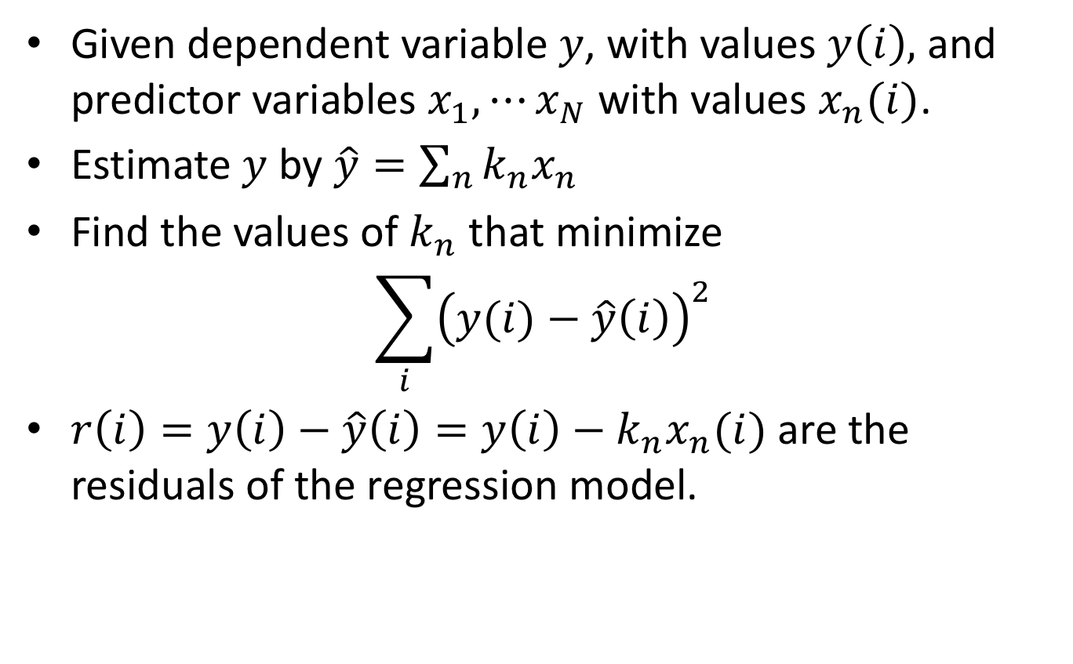
Linear Least-Squares Regression The Work Horse of Most Modeling Procedures
Given dependent variable $y$, with values $y\left(i\right),$ and predictor variables $x_{1},⋯x_{N}$ with values $x_{n}(i)$.
Estimate $y$ by $\hat{y}=\sum_{n}{k_{n}x_{n}}$
Find the values of $k_{n}$ that minimize
$$\sum_{i}{{\left(y(i)−\hat{y}\left(i\right)\right)}^{2}}$$
$r\left(i\right)=y\left(i\right)−\hat{y}\left(i\right)=y\left(i\right)−k_{n}x_{n}(i)$ are the residuals of the regression model.

Slide 12
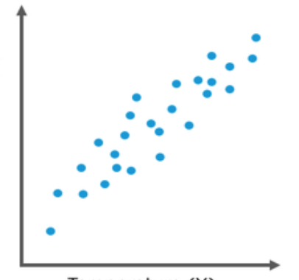
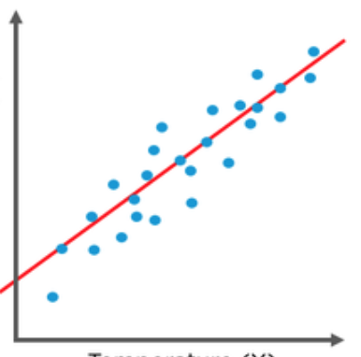
How Least Squares Fits a Line to Data
Line minimizes the sum of the squared residuals.

Slide 13
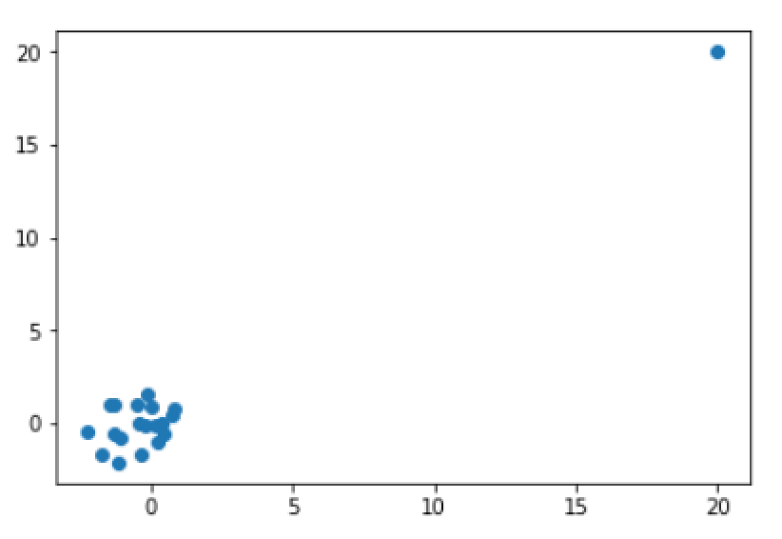
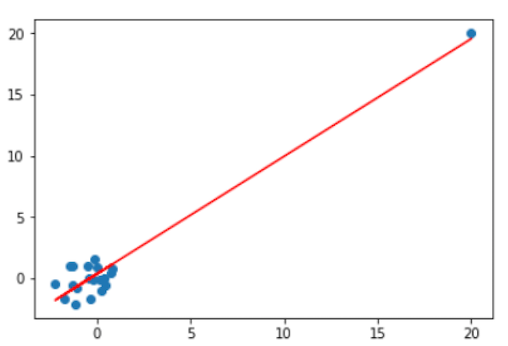

Limitations of Least Squares
What’s the least squares fit for these data?
But doesn’t give smallest squared residuals.
$$R^{2}=0.94$$
Maybe this?
Need outlier detection.

Slide 14
Linear Regression in Python Prepare the Data
LENGTH = 20
STD = 1
# Construct vectors with 19 random values and a 20
xv = np.random.normal(0, STD, LENGTH - 1)
xv = np.concatenate([xv, np.array([LENGTH])])
yv = np.random.normal(0,STD, LENGTH - 1)
yv = np.concatenate([yv, np.array([LENGTH])])
# Construct a matrix (has 1’s in the first column)
mat = np.matrix([np.repeat(1, LENGTH), xv])
mat = mat.transpose() # Transpose to 20 X 2

Slide 15
Linear Regression in Python Fit, Predict, Find Constants, Evaluate
from sklearn import linear_model
from sklearn.metrics import mean_squared_error, r2_score
# Fit, find constants evaluate
regr = linear_model.LinearRegression()
regr.fit(mat, yv)
# Predicted values
y_preds = regr.predict(mat)
# R-squared
rsq = r2_score(yv, y_preds)
# Values of the constants
coefs = regr.coef_
#
print("Predictions: ", y_preds)
print("RSQ: ", rsq)
print("Coeficients: ", coefs)

Slide 16
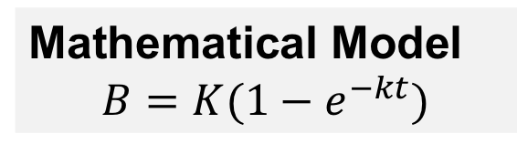
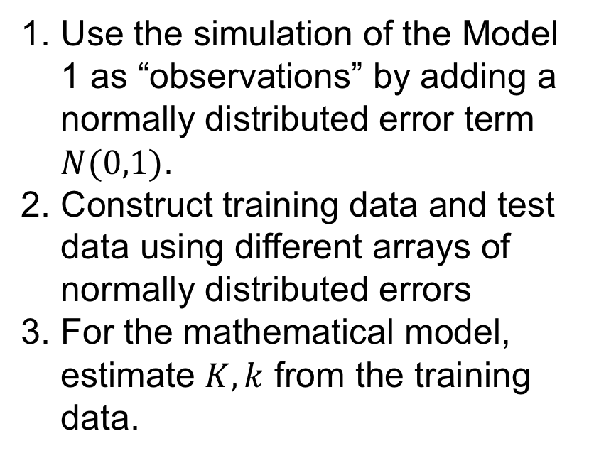
Exercise: Evaluate a Mathematical Model of A System
Model 1
$$→A;v_{0}$$
$$A→B;k_{a}A$$
$$B→C;k_{b}B$$
$$C→;k_{c}C$$
$$v_{0}=10;k_{a}=0.4;$$
$$k_{b}=0.32;k_{c}=k_{a}$$
Mathematical Model
$$B=K(1−e^{−kt})$$
Use the simulation of the Model 1 as “observations” by adding a normally distributed error term $N(0,1)$.
Construct training data and test data using different arrays of normally distributed errors
For the mathematical model, estimate $K, k$ from the training data.

Slide 17
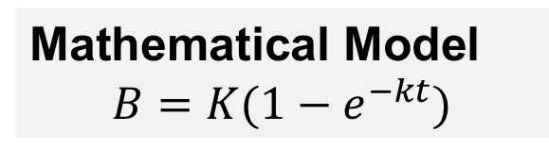

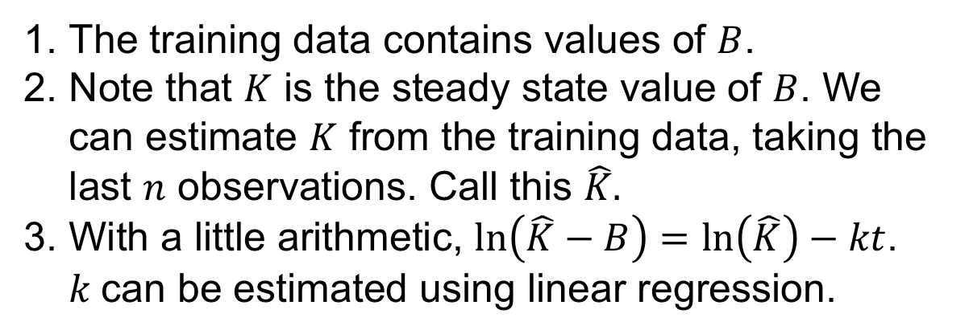
Hint for Estimating $K, k$
Mathematical Model
$$B=K(1−e^{−kt})$$
The training data contains values of $B$.
Note that $K$ is the steady state value of $B$. We can estimate $K$ from the training data, taking the last $n$ observations. Call this $\hat{K}.$
With a little arithmetic, $ln\left(\hat{K}−B\right)=\ln\left(\hat{K}\right)−kt$. $k$can be estimated using linear regression.

Slide 18
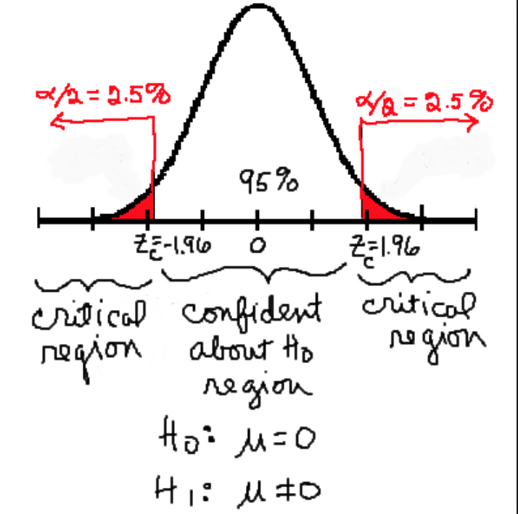
Hypothesis Testing Basics
Null Hypothesis: No change from baseline
Assume data come from a known distribution (e.g., normal).
Calculate a test statistic based on this distribution.
If test statistic is near 0 (not in a critical region), do not reject the Null Hypothesis.
Otherwise, reject the Null Hypothesis.

Slide 19
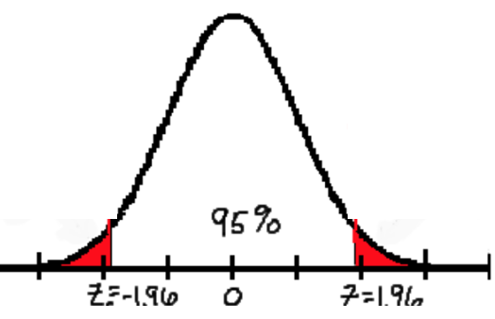
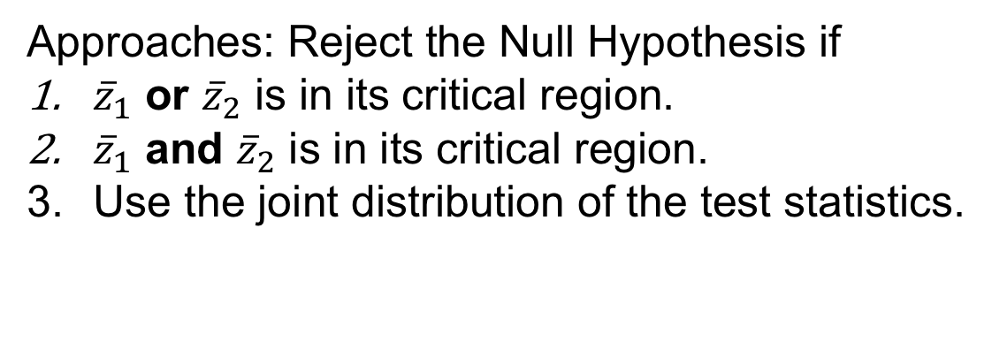


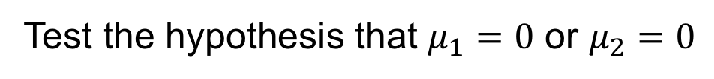
The Multiple Hypothesis Problem
Test the hypothesis that $μ_{1}=0$ or $μ_{2}=0$
$${\overline{z}}_{2}$$
$${\overline{z}}_{1}$$
Approaches: Reject the Null Hypothesis if
${\overline{z}}_{1}$ or ${\overline{z}}_{2}$ is in its critical region.
${\overline{z}}_{1}$ and ${\overline{z}}_{2}$ is in its critical region.
Use the joint distribution of the test statistics.

